Slide 1


CINEMA AND THEATRE MANAGEMENT SYSTEM
Ushake Shravya
002035170

Slide 2


PROBLEM STATEMENT
Lack of coordination across cinema operations
Manual processes for ticketing, staffing, and finances
No structured workflow between Producer → Distributor → Manager
Difficult to scale, poor accountability and customer service

Slide 3





PROPOSED SOLUTION

Slide 4

PROPOSED SOLUTION
Centralized, role-based management system
Request-driven interface connecting all stakeholders
Real-time data routing to Accountant and others
Smooth ticketing, food service, and admin monitoring

Slide 5



ORGANIZATIONAL STRUCTURE

Slide 6

ORGANIZATIONAL STRUCTURE
Enterprise 1: Content & Distribution → Producer, Distributor
Enterprise 2: Operations & Ticketing → Manager, Ticket Seller
Enterprise 3: Services & Support → Concession Staff, Technician
Enterprise 4: Admin & Finance → Admin, Accountant, Customer

Slide 7

ROLES
Admin – System Oversight
Producer – Movie Acquisition
Distributor – Distribution Management
Manager – Staff Supervision & Ticketing
Ticket Seller – Ticket Booking
Customer – Ticket & Food Purchases
Concession Staff – Food Order Fulfillment
Technician – Tech Support
Accountant – Financial Tracking

Slide 8



WORK REQUEST FLOW
MovieAcquisitionRequest: Producer → Distributor
DistributionAssignment: Distributor → Manager
StaffAssignmentRequest: Manager → Technician/Concession Staff
TicketingRequest: Manager → Ticket Seller
TicketBookingRequest: Customer → Ticket Seller
FinancialUpdateRequest: Ticket Seller → Accountant
FoodOrderRequest: Customer → Concession Staff

Slide 9

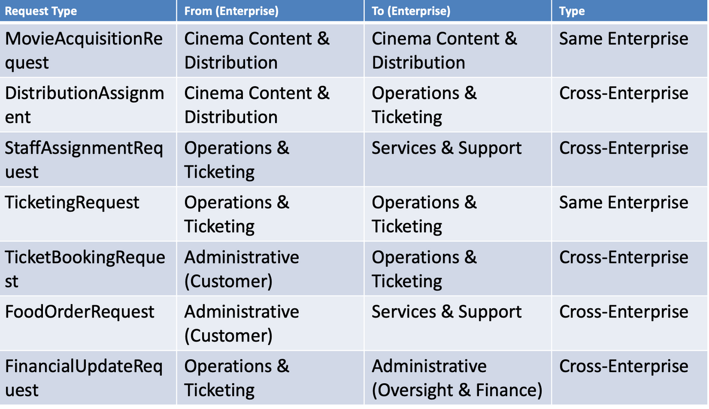
WORK REQUEST TYPE CLASSIFICATION

Slide 10

SMART FEATURES & HIGHLIGHTS
Admin Dashboard with User CRUD
Food Order Notifications ( Sound)
Revenue Reports (JFreeChart: Bar + Pie)
Voice Command Integration (WIP)
In-Memory Data (Faker Setup)
Clean UI with vertical layout structure

Slide 11



THANK YOU!

